Slide 1
Content Moderation and Its Impact on Toxicity on Social Media Platforms
Presented by:
Ameer Hamza
Abdur Rehman

Slide 2

What is Content Moderation ?
Review user generated content
Filter out that content
Remove inappropriate stuff

Slide 4
The 3 Problems
Problem 1
Problem 2
Problem 3
Ineffectiveness of Current Moderation Tools
Adverse Effects on Mental Health
Free Speech vs. User Safety

Slide 5
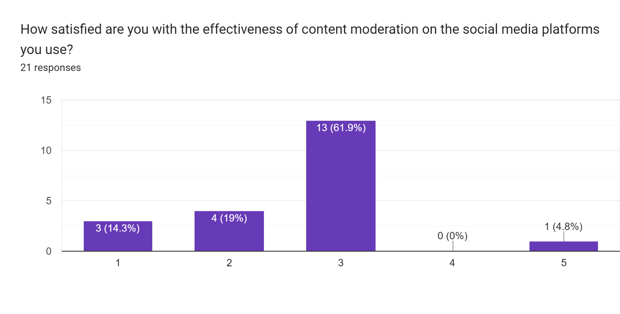

Slide 6
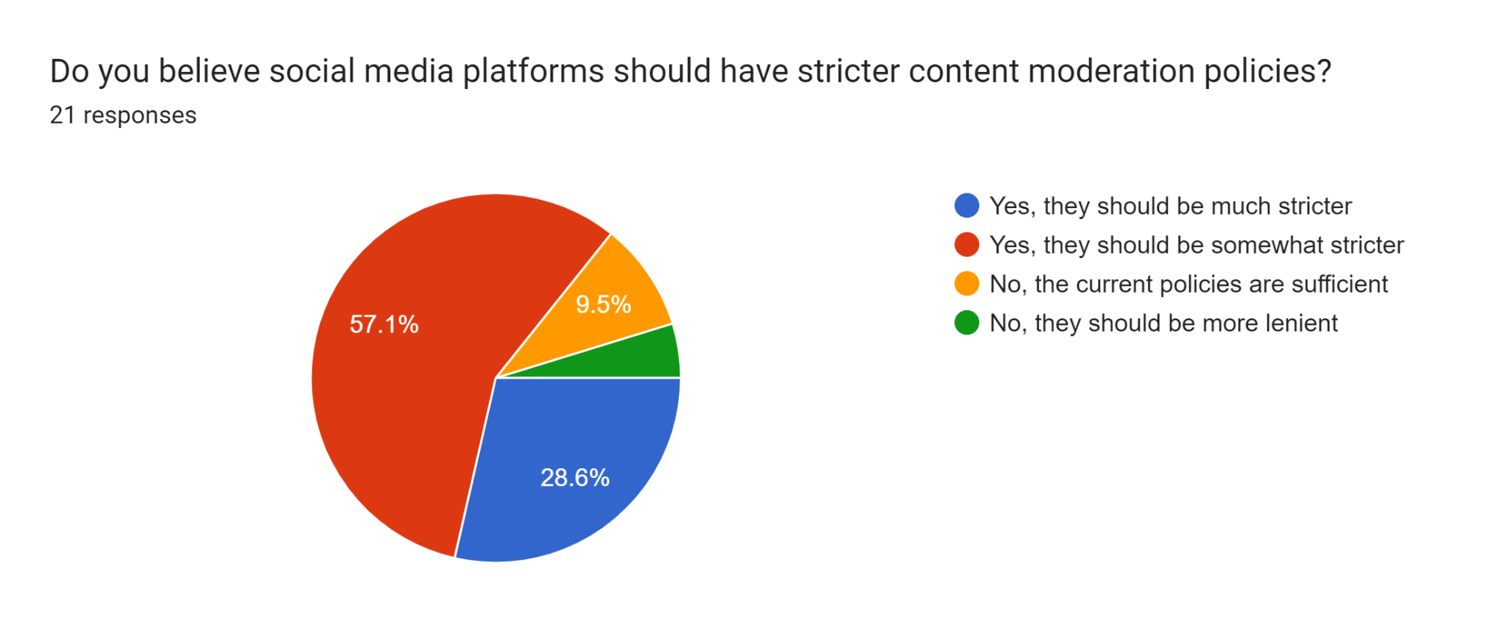

Slide 7

Ineffectiveness of AI Moderation Bots
Difficult to train on different languages

